Slide 1
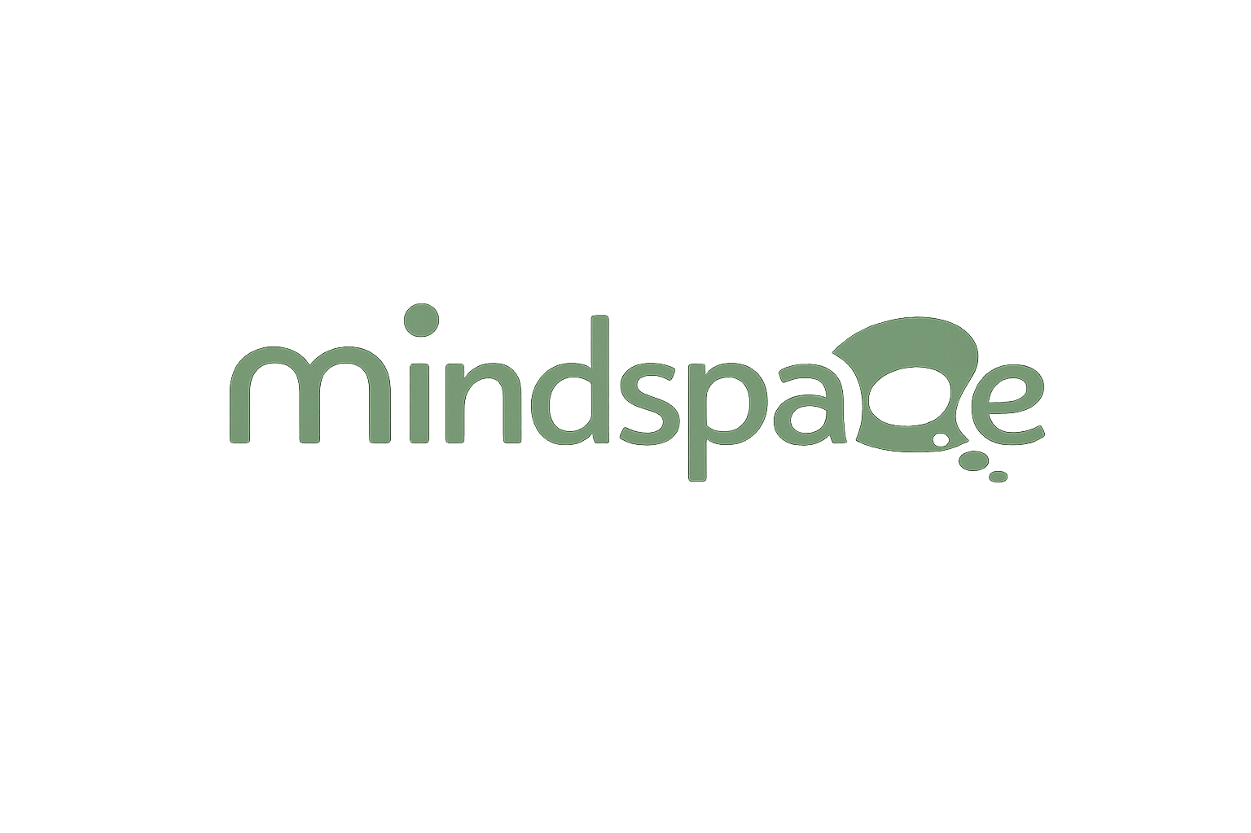

🤖
My Voice
Summer Camp 2026
AI Explorers Academy
Discovering Artificial Intelligence
🌟 No Coding Required • Just Explore & Have Fun! 🌟
1
2
3
4
5
6
Intro
to AI
How AI
Learns
AI Finds
Patterns
AI Makes
Pred.
AI in
Daily Life
Fun
Project! 🎮

Slide 2

🗺️ Your AI Journey
6 exciting stops along the way!
🤔
📚
🔍
🔮
📱
🎮
Intro to AI
How AI Learns
AI Finds Patterns
AI Makes Predictions
AI in Daily Life
Fun Project
What is AI?
Training & examples
Spotting the repeat
Smart guesses!
AI is everywhere!
Play & celebrate!
1
2
3
4
5
6
🚀 Ready? Let's explore AI together!

Slide 3
3
🔍
Phase 3
AI Finds Patterns
AI's amazing superpower!

Slide 4
🔍 What Is a Pattern?
A pattern is something that repeats in a predictable way!
AI is AMAZING at spotting patterns — even hidden ones 🕵️
🖼️
Image Patterns
🎵
Sound Patterns
Faces, cats, dogs, traffic signs
Music, voices, alarms
📊
Behavior Patterns
💬
Language Patterns
What you watch, buy, or click
Words you use most often
🔗 Video Link: https://youtu.be/jEBLCZ6LtPM?si=IQ3O7X53G568QEpN

Slide 5
🌍 AI Patterns in Real Life
🔓
⛅
🎵
Face Unlock
Weather AI
Shazam
Learns your face pattern — every unique dot and curve!
Spots patterns in temperature and clouds to predict rain!
Recognizes a song's sound wave pattern in seconds!

Slide 6
🎯 Activity: Pattern Detective!
Find the hidden patterns! 🕵️
1️⃣ You'll see a sequence of shapes, colors, or numbers
2️⃣ Look carefully — what repeats? What comes next?
3️⃣ Write your guess on your sheet
4️⃣ Compare with your classmates — did you find it?
🔗 Activity Link: abdelrahmansaeed28.wixstudio.com/phase3-activity

Slide 7
❓ Quick Question!
Why does Netflix suggest shows you might like?
It guesses randomly 🎲
A
It found YOUR watching pattern 📊
B
✅
Your friend told Netflix 🤷
C

Slide 8
⭐ Phase 3 Recap
🔍 Patterns are things that repeat in a predictable way!
🎵 AI spots patterns in images, sounds, behavior & language!
📺 Netflix and Spotify use YOUR patterns to suggest things!
👀 Coming next: AI makes smart guesses about the FUTURE! 🔮

Slide 9
4
🔮
Phase 4
AI Makes Predictions
Smart guesses about the future!

Slide 10
🔮 What Is a Prediction?
A prediction is a smart guess based on patterns!
The more data AI has, the better its guesses! 🎯
⛅
Weather Prediction
⌨️
Keyboard Autocomplete
AI says '80% chance of rain today!'
Phone guesses your next word!
📈
Gets Better with Data
⚡
Super Fast
More data = better predictions!
AI predicts in milliseconds!

Slide 11
🌍 Predictions in Real Life
📱
⚽
🎬
Text Autocomplete
Sports AI
Netflix Next Episode
Your phone predicts what word you'll type next!
Predicts player injuries and match outcomes!
Predicts which show you want to watch next!

Slide 12
🎮 Activity: Future Predictor Game!
Be a human prediction machine! 🔮
1️⃣ Look at the clues shown on the screen
2️⃣ Make your best PREDICTION — what comes next?
3️⃣ See if your prediction was correct!
4️⃣ Discuss: how is this like what AI does? 💬
🔗 Activity: claude.ai/public/artifacts/61965808-89f4-4b6d-aa7b-09cc3c586626

Slide 13
❓ Quick Question!
What helps AI make better predictions?
Fewer examples 📉
A
More data & examples 📊
B
✅
Taking a break 😴
C

Slide 14
⭐ Phase 4 Recap
🔮 A prediction is a smart guess based on patterns!
📊 More data = better, smarter predictions!
⚡ AI makes predictions in milliseconds — super fast!
👀 Next: AI in YOUR daily life — it's everywhere! 📱

